Slide 1
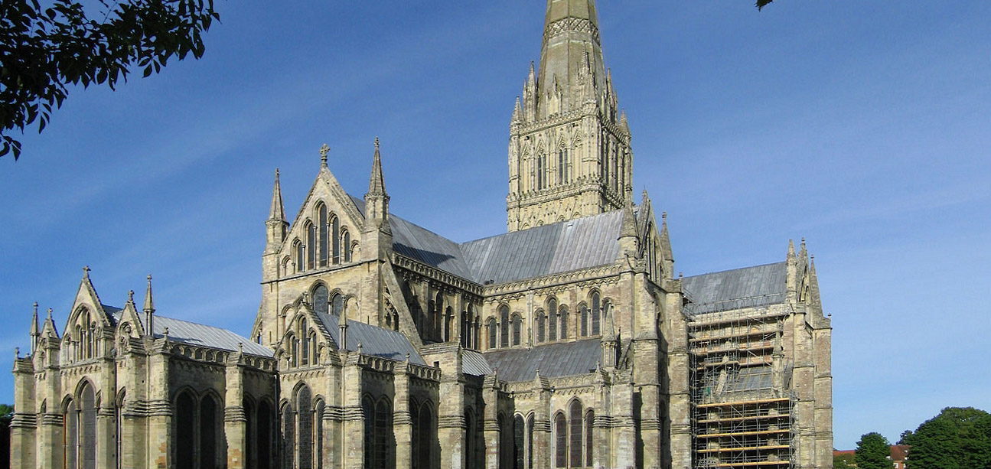
Lessons from Church History
Week 2: Lessons from the Early Church Fathers

Slide 2
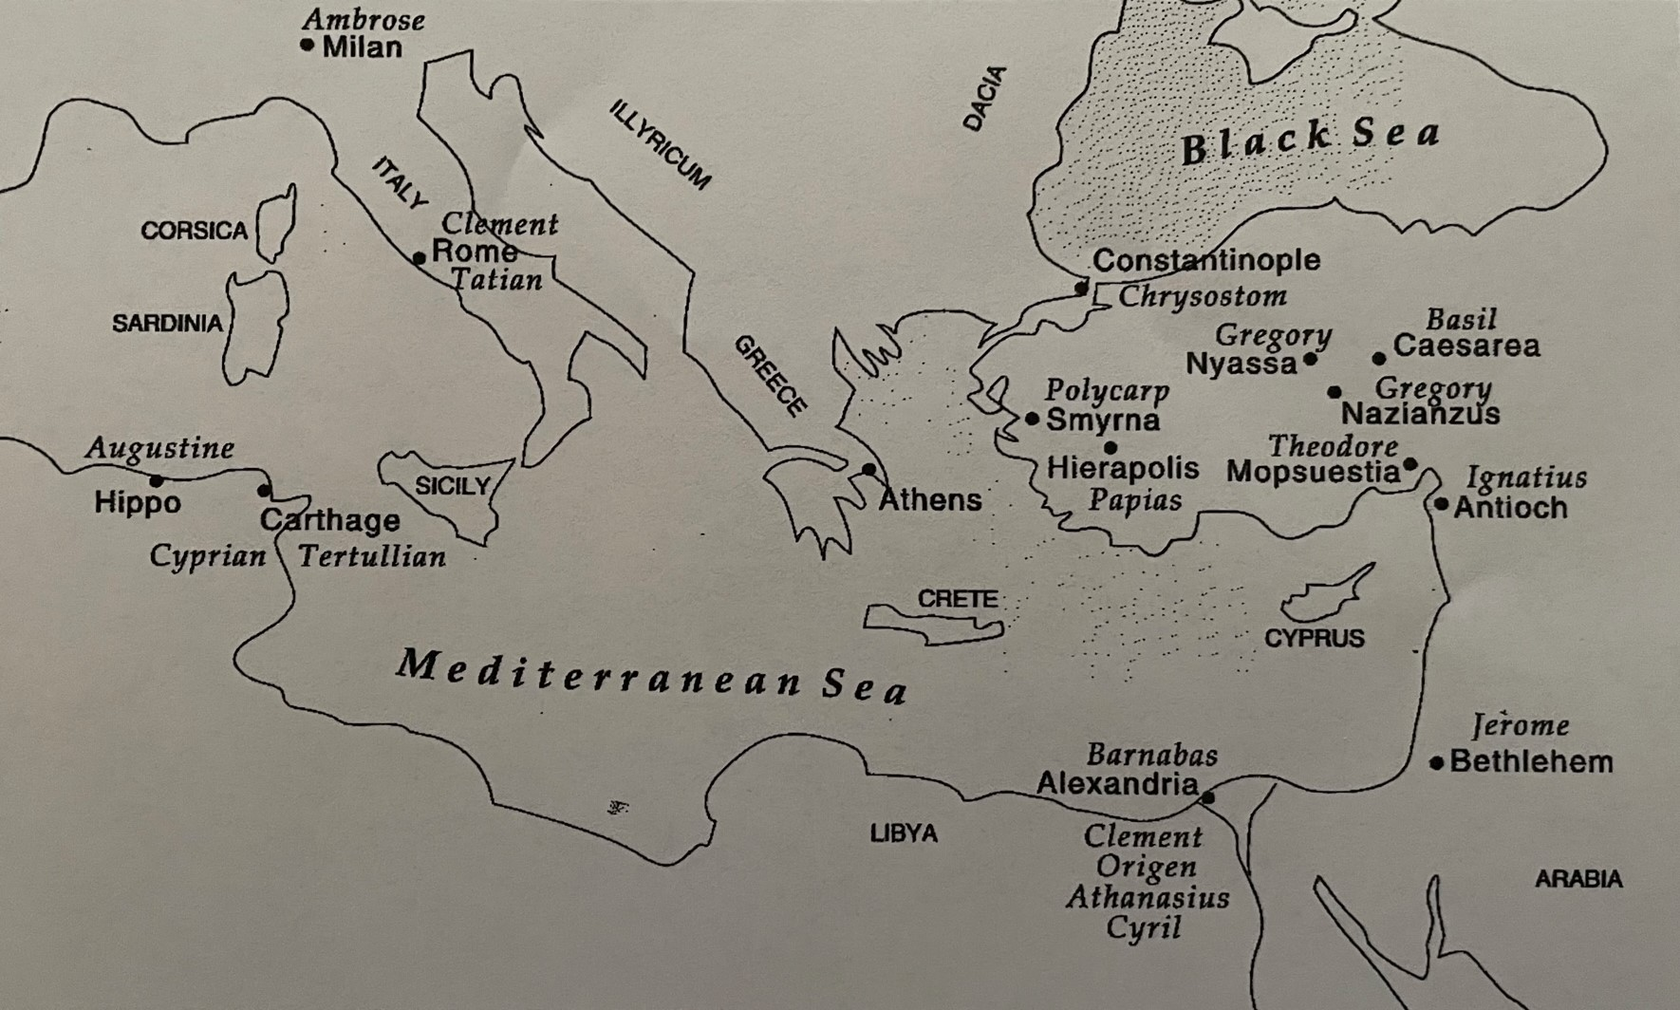
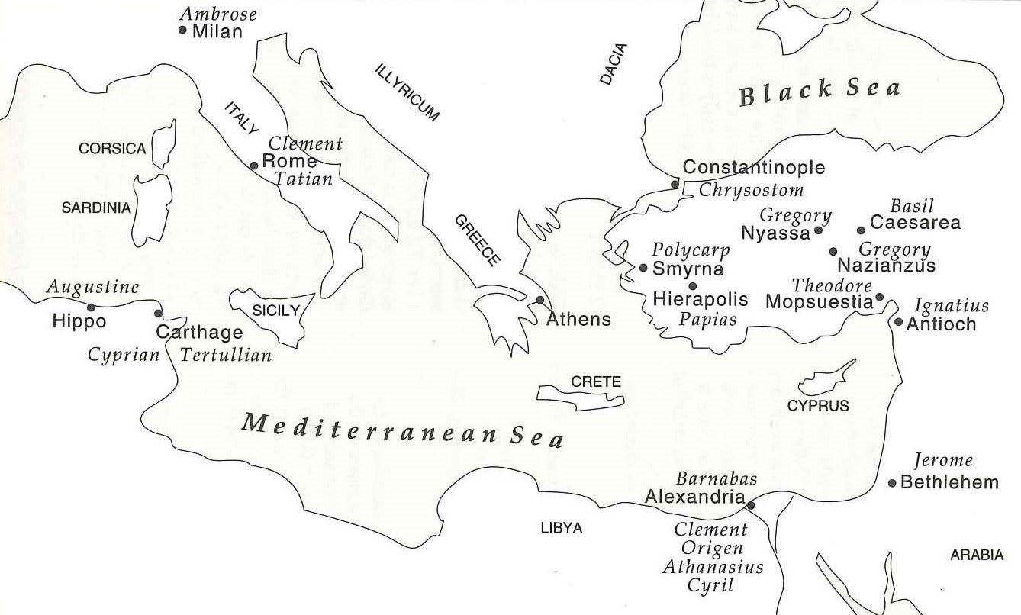
Lessons from the early church fathers
Map of
Early
Church
Fathers

Slide 3
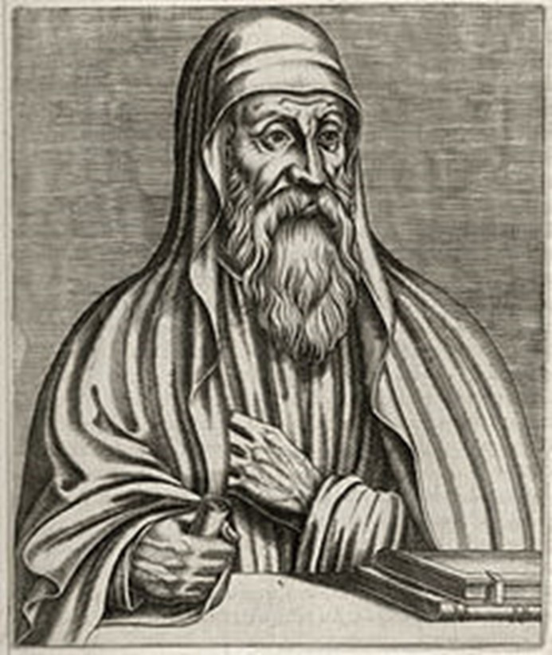
Lessons from the early church fathers
ORIGEN
(185-253 AD) – Alexandria, Egypt
Born into a wealthy Christian family, his father was arrested and imprisoned when Origen was 16. His mother thwarted his attempt to join his father in martyrdom, leaving him to care for her and the 8 remaining children. Rome confiscated all of their property, leaving them impoverished.
One of the most prolific writers in all ancient history, Origen produced thousands of works, from apologetics to practical commentaries across almost the entire Bible.

Slide 4
Lessons from the early church fathers
ORIGEN
His work On First Principles is the earliest systematic theology which has come down through the church.
He established a Christian school in Caesarea in 231 after which he reached the peak of influence. Origen was not without controversy however…
Origen endured 2 years of imprisonment and torture from 249 to 251, refusing to renounce Christ. When Decius, the Emperor who ordered the persecution was killed in battle, Origen was released from prison. He died less than a year later at the age of 69.

Slide 5
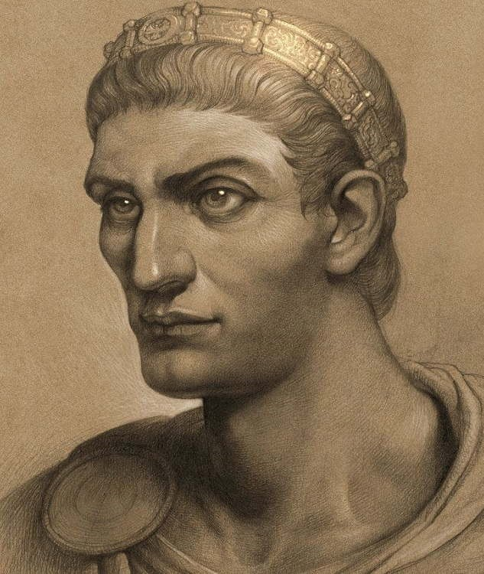
Lessons from the early church fathers
CONSTANTINE
(272-337 AD) – Roman Emperor
Born of a Roman officer named Constantius and a Greek woman of low birth named Helena who was a Christian. Came to power in 306 after the death of his father and support of his loyal soldiers. Tetrarchy and East v. West.
Won the battle of Milvian Bridge after a vision, “In this conquer”.
Edict of Milan in 313 granted “full authority to follow whatever worship each man has desired.”
He rebuilt destroyed churches with the Roman treasury, granted monies to churches, and called the Councils in Arles and Nicaea. He wrested total control of the Empire in 324 and founded Constantinople (modern day Istanbul, Turkey)

Slide 6
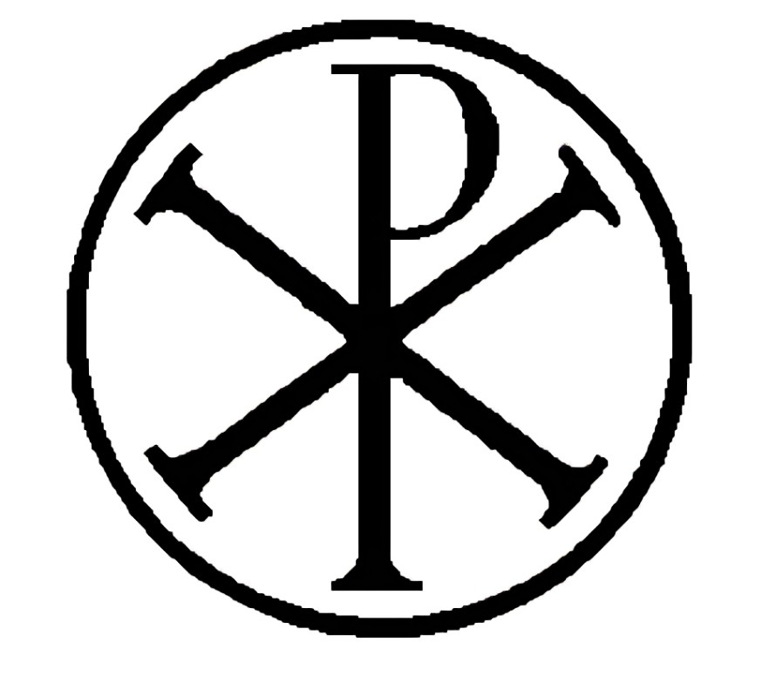
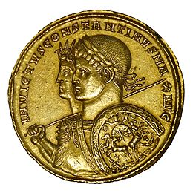
Lessons from the early church fathers
CONSTANTINE
The church passed from persecution to privilege in an amazingly short time.
The Chi Rho symbol is also called the Chrismon and is one of the earliest forms of the Christogram. First two Greek letters of Christos.
Constantine's impact on Christianity: He declared himself a Christian at age 40. Introduced tax-exempt status for churches, built basilicas (including Church of the Holy Sepulchre and Old St. Peter's Basilica), and legislated Sunday as a day of rest.
Halo Phenomenon (sun dog/ parhelion)

Slide 7
Lessons from the early church fathers
Map of
Early
Church
Fathers

Slide 8
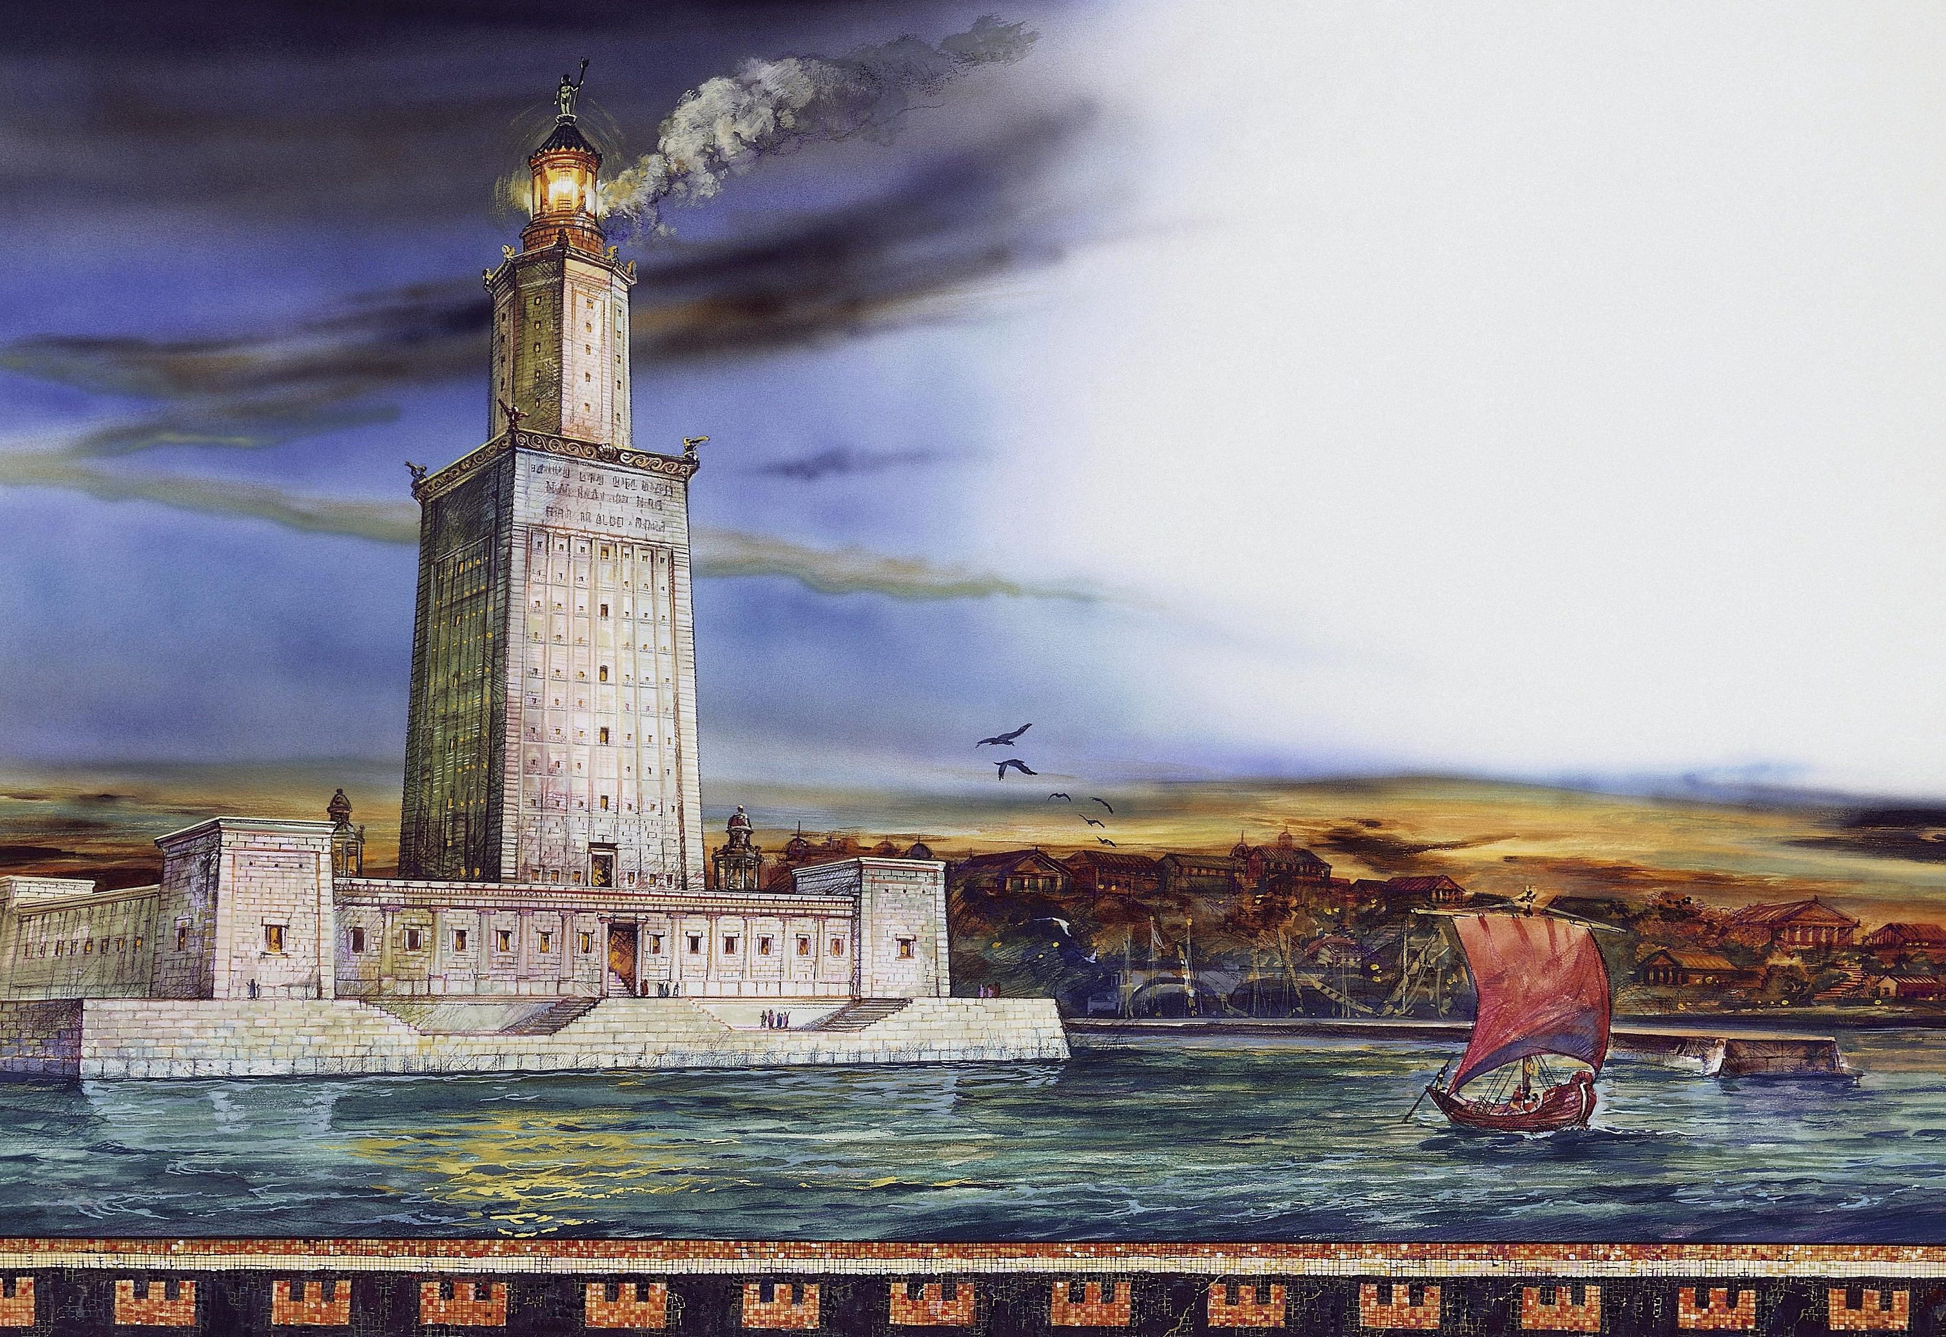
Lessons from the early church fathers alexandria
Pharos Lighthouse
One of the 7 Wonders of the Ancient World. 400 feet tall (taller than Statue of Liberty)

Slide 9
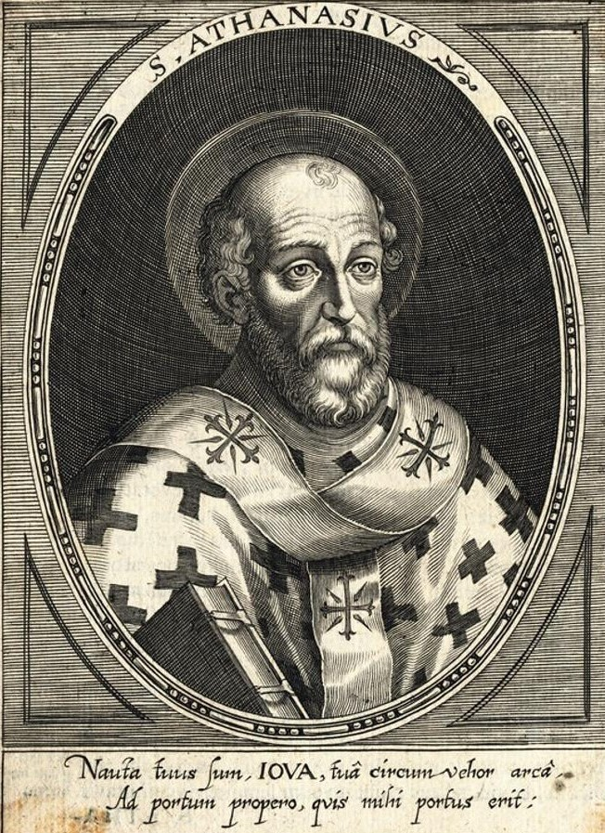
Lessons from the early church fathers
ATHANASIUS
(298-373 AD) – Bishop of Alexandria
Discipled by Alexander. Attended the Council of Nicaea at age 27. Replaced Alexander as bishop of Alexandria at age 30. Fought one of the greatest battles in church history against the errors of Arianism almost single-handedly.
Note Athanasius contra mundum (‘against the world’). He called the Arians “Ariomaniacs.”
Exiled 5 times. Spent 17 of his 46 years as bishop in exile. Wrote On the Incarnation of Christ, one of the greatest theological treatises in history.
Gregory of Nazianzus said he “meditated on every book of the OT and NT with a depth that no one else had applied to even one book.”

Slide 10
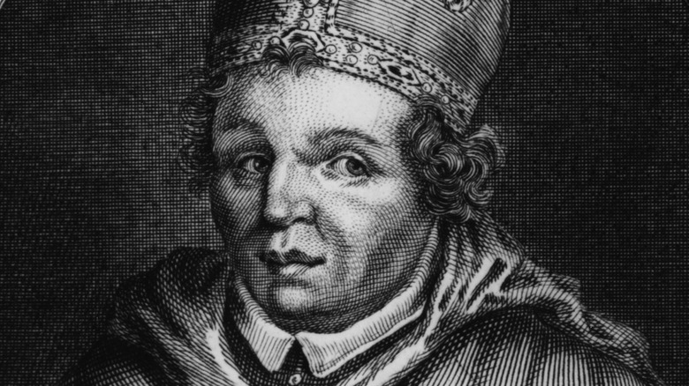
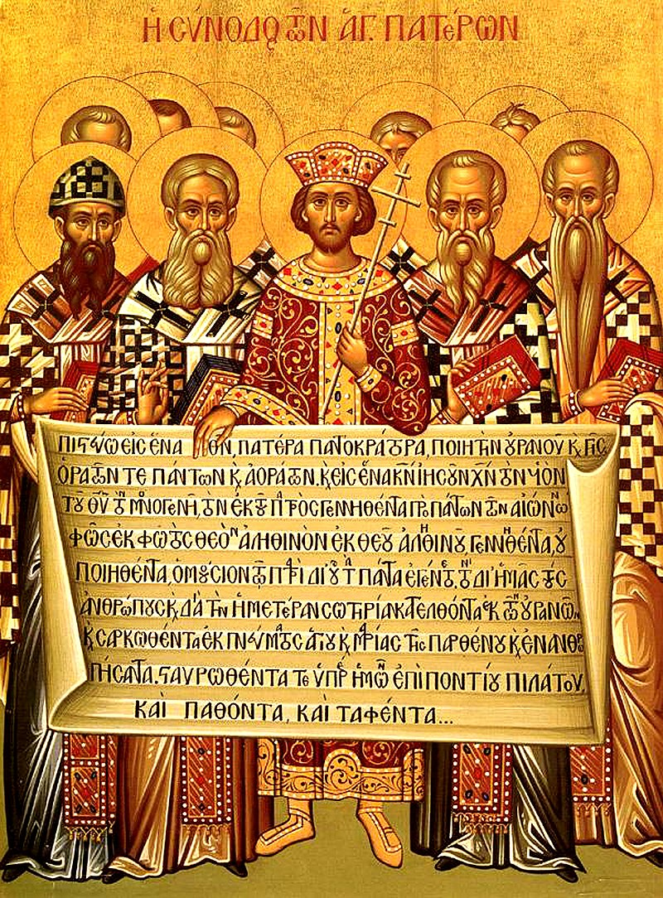
Lessons from the early church fathers
ARIANISM
Arius (256-336) taught the Son was (1) a created being, (2) not eternal, and (3) a sub-deity to the Father. His teaching spread like wildfire. He even wrote hymns that celebrated this heresy.
The doctrine of the Trinity was taken for granted and not well-articulated prior to this crisis.
Constantine called for the first ecumenical council to address the controversy: The Council of Nicaea in 325. 318 bishops attended. Many suffered torture during the ‘Great Persecution’ of Diocletian from 303-311 before Constantine.
Key statement from Nicaea: Christ is “of the substance of the Father, God of God, Light of Light, true God of true God, begotten not made, consubstantial [“of the same substance” (homoousios)] with the Father.”
Arius of Alexandria
Constantine and the Bishops at the Council of Nicaea

Slide 11
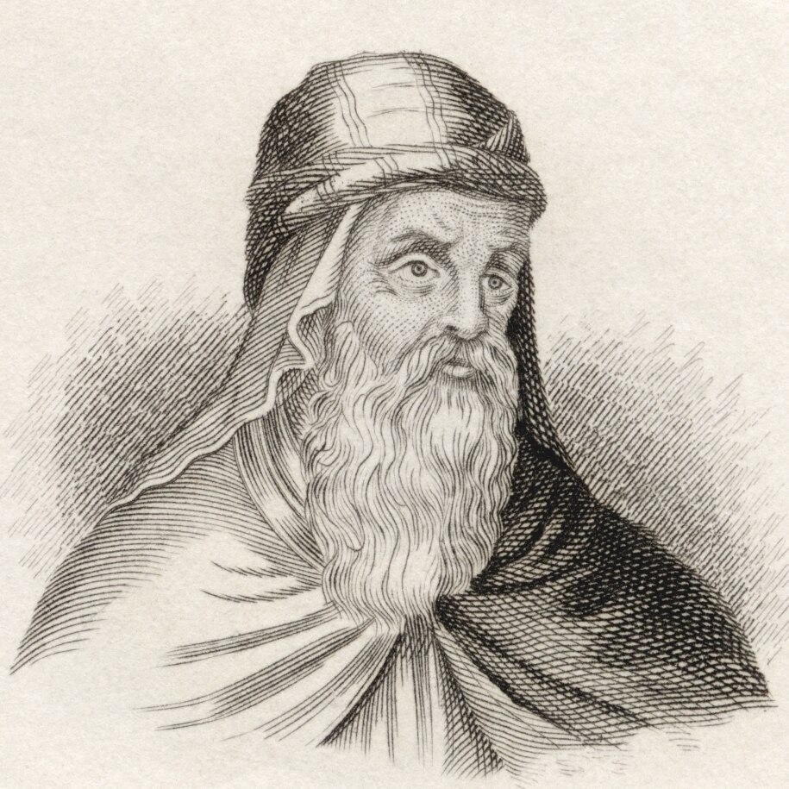
Lessons from the early church fathers
ARIANISM
Nicaea did not end the controversy. Athanasius’ Arian enemies issued all sorts of false charges to discredit him, including murder and witchcraft. He easily defended himself in court.
New, unofficial councils were set up to continue the debate, some that included violent brawls.
The Cappadocian Fathers rose up in 360 to defend Nicene orthodoxy: Gregory of Nazianzus and his friends Basil of Caesarea and Basil’s younger brother, Gregory of Nyssa.
8 years after Athanasius died, the First Council of Constantinople (381) called by Theodosius I finally saw the triumph of Nicene orthodoxy. It was attended by 150 bishops overseen by Gregory of Nazianzus. However, Trinitarian heresies were fought for another 300 years.
Gregory of Nazianzus

Slide 12
Lessons from the early church fathers
Map of
Early
Church
Fathers

Slide 13
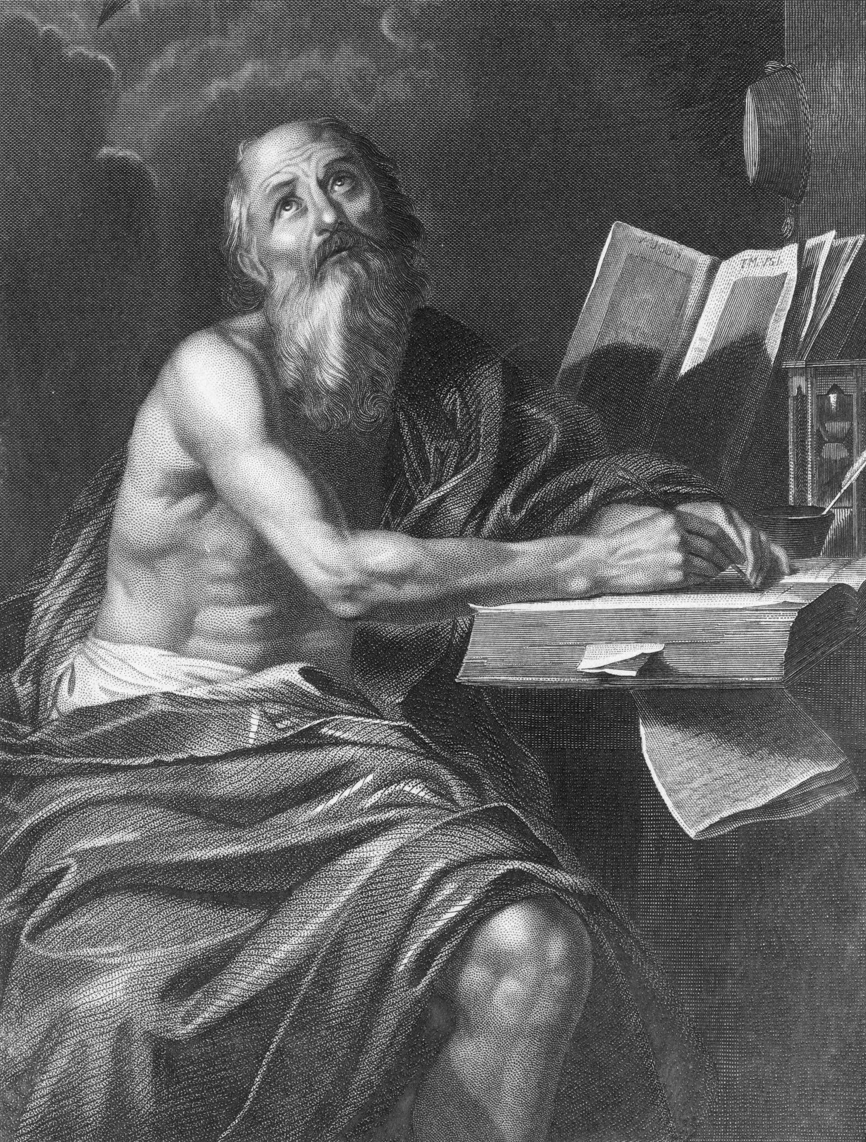
Lessons from the early church fathers
JEROME
(342-420 AD) – Scholar, Bethlehem
Baptized at age 19 in northern Italy, educated in Rome. Traveled to Gaul, Constantinople, and Italy while perfecting Greek, Latin, and Hebrew. One of the greatest scholars of his age.
In 382, he began a new Latin translation of the Bible from original Hebrew of the OT, correcting inaccuracies to create a uniform standard Bible.
Completed in 405. Known as the Vulgate.
"Only the original text is free from error" was his guiding philosophy.
During those 23 years (in Bethlehem) he also wrote commentaries on almost every book of the Bible, fought theological battles, and served as a spiritual counselor.

